Slide 1

John 10:22-42
As WITH the Father,
So, WITH the Son
Preached by Rev. Manik Corea
at Crossroads International Church Singapore • CICFamily.com
Uploaded by Dr. Rick Griffith • Jordan Evangelical Theological Seminary
Files in many languages for free download at BibleStudyDownloads.org

Slide 2

Believing
C H R I S T
Responding to John’s Gospel
Notes:
Today’s sermon is the third in a series called Believing Christ, Responding to John’s Gospel account.
And here is a spoiler alert: everyone who hears the gospel, or good news, in our story today, in verses 35-51, responds by believing that Jesus is the Christ.
But, even though we know how they responded, we can still learn something by looking at the various circumstances leading up to,
as well as the differences in their actual reactions.

Slide 3
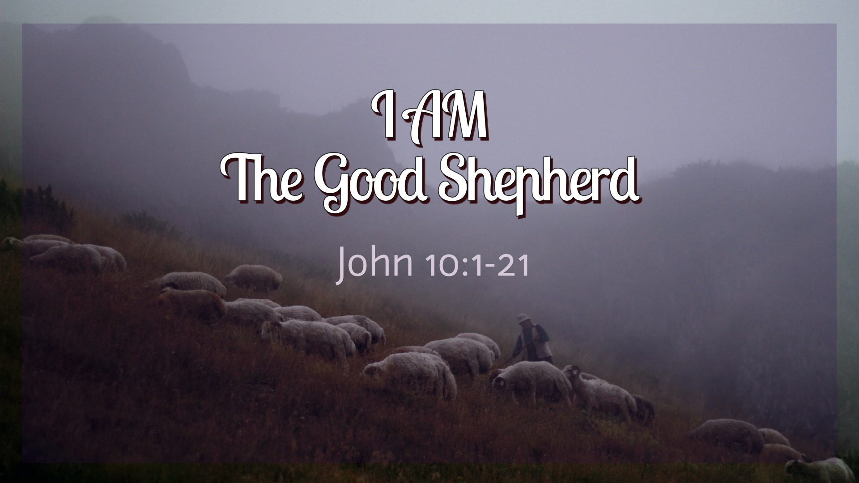

Slide 4
²² At that time the Feast of Dedication took place at Jerusalem. It was winter, ²³ and Jesus was walking in the temple, in the colonnade of Solomon. ²⁴ So the Jews gathered around him and said to him, “How long will you keep us in suspense? If you are the Christ, tell us plainly.” ²⁵ Jesus answered them, “I told you, and you do not believe. The works that I do in my Father's name bear witness about me, ²⁶ but you do not believe because you are not among my sheep. ²⁷ My sheep hear my voice, and I know them, and they follow me. ²⁸ I give them eternal life, and they will never perish, and no one will snatch them out of my hand. ²⁹ My Father, who has given them to me, is greater than all, and no one is able to snatch them out of the Father's hand. ³⁰ I and the Father are one.”

Slide 5

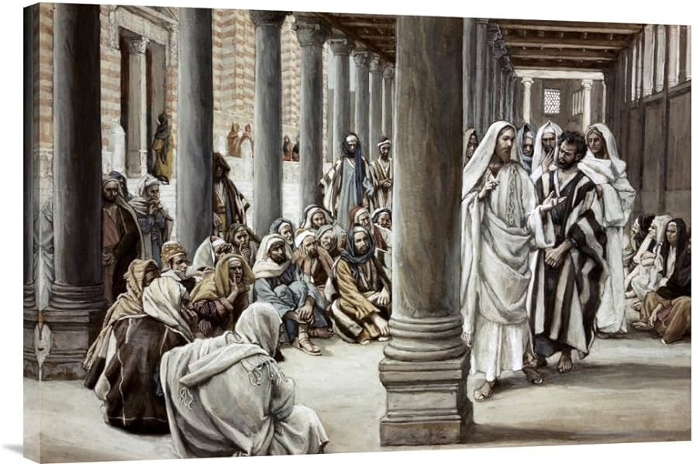
John 10:22-30
Vs 22 - Feast of Dedication = Hanukkah (around Nov/Dec).
Vs 24 - ”Jews” codeword for Jewish religious leaders, i.e. Pharisees and Sadducees.
Vs 25a – Jesus revealed himself as the Christ to Samaritan woman at the well (4:26) and to the blind man (9:35-36). In his dialogue with the Jewish leaders, he never hid his identity (John 5:19-47, 6:28-49,7:16-19, 28-29, 8:48-58, etc.)
Vs 25b-26 – His miracles witness to Who He is. They don’t believe because they are not his sheep who know and follow Him.

Slide 6
²² At that time the Feast of Dedication took place at Jerusalem. It was winter, ²³ and Jesus was walking in the temple, in the colonnade of Solomon. ²⁴ So the Jews gathered around him and said to him, “How long will you keep us in suspense? If you are the Christ, tell us plainly.” ²⁵ Jesus answered them, “I told you, and you do not believe. The works that I do in my Father's name bear witness about me, ²⁶ but you do not believe because you are not among my sheep. ²⁷ My sheep hear my voice, and I know them, and they follow me. ²⁸ I give them eternal life, and they will never perish, and no one will snatch them out of my hand. ²⁹ My Father, who has given them to me, is greater than all, and no one is able to snatch them out of the Father's hand. ³⁰ I and the Father are one.”

Slide 7
³¹ The Jews picked up stones again to stone him. ³² Jesus answered them, “I have shown you many good works from the Father; for which of them are you going to stone me?” ³³ The Jews answered him, “It is not for a good work that we are going to stone you but for blasphemy, because you, being a man, make yourself God.” ³⁴ Jesus answered them, “Is it not written in your Law, ‘I said, you are gods’? ³⁵ If he called them gods to whom the word of God came—and Scripture cannot be broken— ³⁶ do you say of him whom the Father consecrated and sent into the world, ‘You are blaspheming,’ because I said, ‘I am the Son of God’? ³⁷ If I am not doing the works of my Father, then do not believe me; ³⁸ but if I do them, even though you do not believe me, believe the works, that you may know and understand that the Father is in me and I am in the Father.” ³⁹ Again they sought to arrest him, but he escaped from their hands.

Slide 8
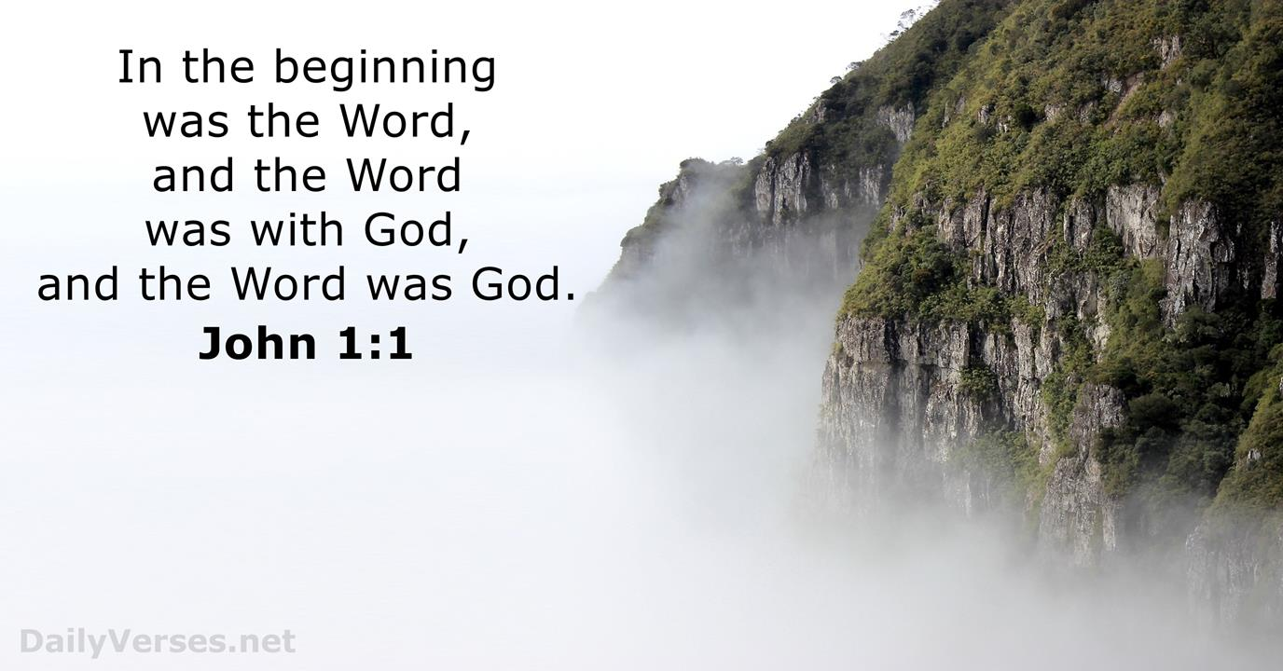

Slide 9
John 10:31-38
1) Vs 33 - Jews understood Jesus was claiming to be God. Stoning was the punishment for blasphemy (Leviticus 24:23).

Slide 10
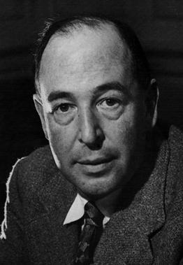
“You must make your choice. Either this man was, and is the Son of God; or else a madman or something worse…but let us not come up with any patronising nonsense about His being a great human teacher. He has not left that open to us. He did not intend to.”
C.S. Lewis, Mere Christianity, Harper Collins, 2023, page 55-56.

Slide 11
³¹ The Jews picked up stones again to stone him. ³² Jesus answered them, “I have shown you many good works from the Father; for which of them are you going to stone me?” ³³ The Jews answered him, “It is not for a good work that we are going to stone you but for blasphemy, because you, being a man, make yourself God.” ³⁴ Jesus answered them, “Is it not written in your Law, ‘I said, you are gods’? ³⁵ If he called them gods to whom the word of God came—and Scripture cannot be broken— ³⁶ do you say of him whom the Father consecrated and sent into the world, ‘You are blaspheming,’ because I said, ‘I am the Son of God’? ³⁷ If I am not doing the works of my Father, then do not believe me; ³⁸ but if I do them, even though you do not believe me, believe the works, that you may know and understand that the Father is in me and I am in the Father.” ³⁹ Again they sought to arrest him, but he escaped from their hands.

Slide 12
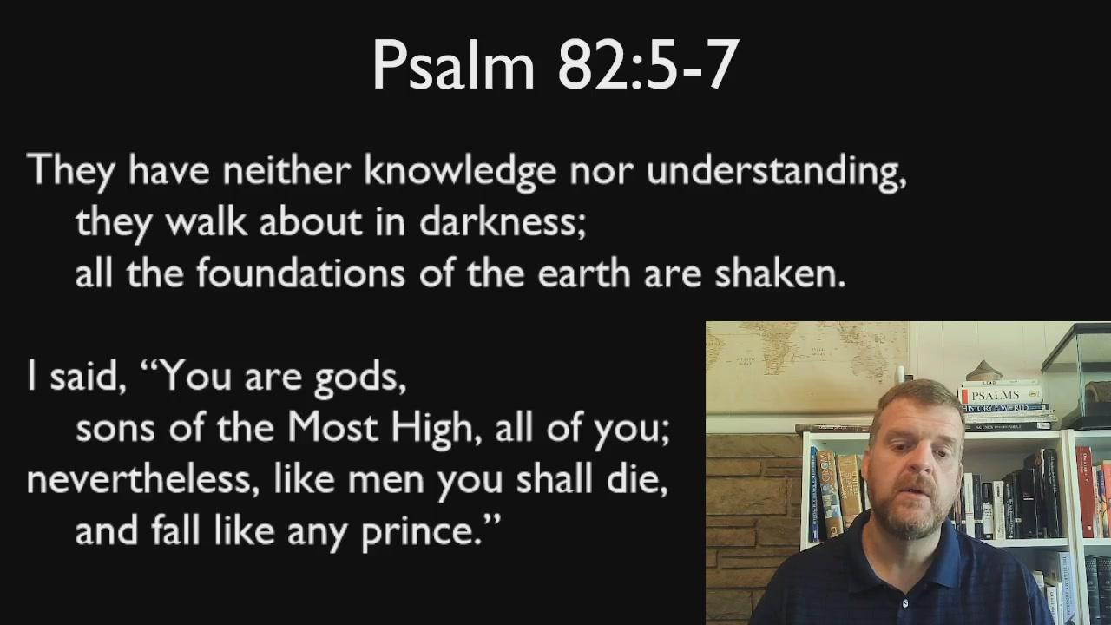
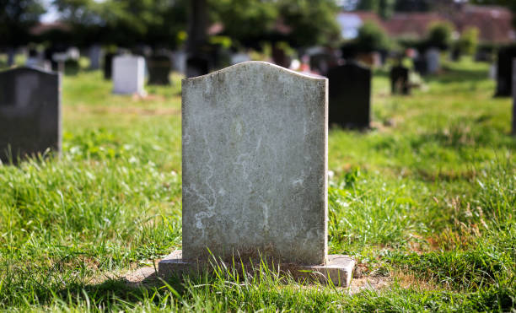

Slide 13
John 10:31-38
1)Vs 33 - Jews understood Jesus was claiming to be God. Stoning was the punishment for blasphemy (Leviticus 24:23).
2) Vs 36 – Jesus claimed to be set apart and sent into the world by the Father (compare John 8:58).
3) Vs 37 – Jesus claims to do the works/signs of the Father, so they must believe him.

Slide 14
³⁹ Again they sought to arrest him, but he escaped from their hands.
⁴⁰ He went away again across the Jordan to the place where John had been baptizing at first, and there he remained. ⁴¹ And many came to him. And they said, “John did no sign, but everything that John said about this man was true.” ⁴² And many believed in him there.

Slide 15
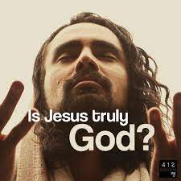
And what will do you about it?

Slide 16
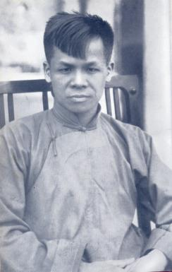
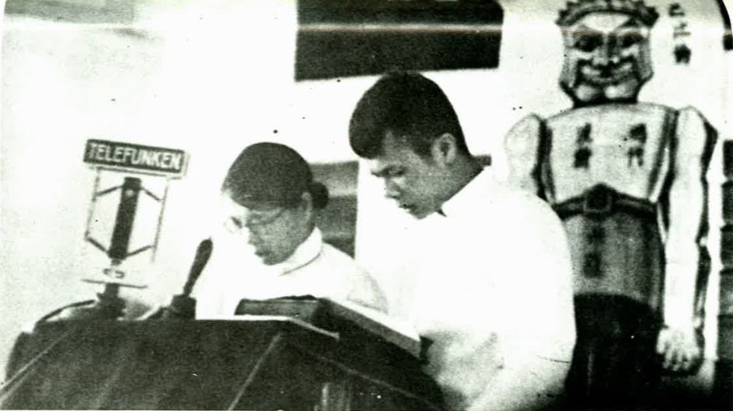
John Sung
1901-1944

Slide 17
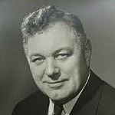
“The tragedy of modern evangelicalism is calling many to profession, few to obedience.”
Donald Gray Barnhouse,
US Theologian and Pastor

Slide 18
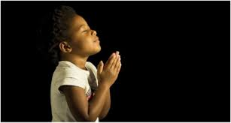
LET US PRAY….

Slide 19
Black

Slide 20


NT Preaching link at BibleStudyDownloads.org
Get this presentation and script for free!
Notes:
NT Preaching (np)

